Slide 1
Microsoft Azure AI Fundamentals: Generative AI
Notes:
This content is meant to be taught in companion to: Microsoft Azure AI Fundamentals: Generative AI - Training | Microsoft Learn

Slide 2
Agenda
Fundamentals of Generative AI
Fundamentals of Azure OpenAI Service
Explore responsible Generative AI
Notes:
Estimated timing:
- Fundamentals of generative AI: 30 minutes
- Lab: Explore Microsoft Copilot: 40 minutes
- Fundamentals of Azure OpenAI Service: 30 minutes
- Explore responsible Generative AI: 10 minutes

Slide 3
Learning Objectives
After completing this module, you will be able to:
1
Describe Generative AI, what language models are and how they are used.
2
Understand how to use generative AI across Microsoft Copilot solutions.
3
Describe Azure OpenAI capabilities and how to use Generative AI responsibly.

Slide 4
Fundamentals of Generative AI
Notes:
https://learn.microsoft.com/training/modules/fundamentals-generative-ai/
In this module you'll explore the way in which large language models (LLMs) enable AI applications and services to generate original content based on natural language input. You’ll also learn how generative AI enables the creation of AI-powered copilots that can assist humans in creative tasks.
By the end of this section, you'll be able to:
Understand generative AI's place in the development of artificial intelligence
Understand large language models and their role in intelligent applications
Describe how Azure OpenAI supports intelligent application creation
Describe examples of copilots and good prompts

Slide 5
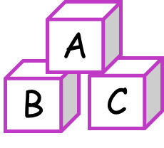


What is Generative AI?
Language model
Natural language generation
Image generation
Code generation
Write a cover letter for a job application
Create a logo for a florist business
Write Python code to add two numbers
Dear <recipient>,
Please find enclosed my application for the role of …
def add(n1, n2):
result = n1 + n2;
return result;
Daisy’s
Flowers
Notes:
AI imitates human behavior by using machine learning to interact with the environment and execute tasks without explicit directions on what to output. Generative AI is a subset of AI in which an AI model creates original content in response to a natural language prompt. Generative AI applications take in natural language input, and return appropriate responses in a variety of formats:
Natural language generation
To generate a natural language response, you might submit a prompt such as "Give me three ideas for a healthy breakfast including peppers.“ or “Write a cover letter for my resume.”
Image generation
Some generative AI applications can interpret a natural language request and generate an appropriate image. For example, you might submit a request like "Create an image of an elephant eating a burger“ or “Create a logo for a florist business”
Code generation
Some generative AI applications are designed to help software developers write code. For example, you could submit a request like "Show me how to code a game of tic-tac-toe with Python“ or “Write Python code to add two numbers”

Slide 6





Language models A (very) high-level overview
Transformer Model
Training text
Encoder
Encode text tokens as vectors (embeddings)
 | dog | [10,3,2]
 | cat | [10,3,1]
 | puppy | [5,2,1]
 | skateboard | [-3, 3, 2]
Training
Input
(prompt)
Decoder
Embedding vectors encapsulate semantic attributes in multiple dimensions
(related words have similar orientation)
When my dog was…
Generate natural language sequences
Output
(completion)
… a puppy
Inferencing
Notes:
While the mathematical principles behind language models can be complex, a basic understanding of the architecture used to implement them can help you gain a conceptual understanding of how they work.
Today's cutting-edge large language models are based on the transformer architecture, which builds on and extends some techniques that have been proven successful in modeling vocabularies to support NLP tasks - and in particular in generating language. Transformer models are trained with large volumes of text, enabling them to represent the semantic relationships between words and use those relationships to predict probable sequences of text that make sense. Transformer models with a large enough vocabulary are capable of generating language responses that are tough to distinguish from human responses.
In practice, the specific implementations of the architecture vary – for example, the Bidirectional Encoder Representations from Transformers (BERT) model developed by Google to support their search engine uses only an encoder block to generate semantic vector representations of text, while the Generative Pretrained Transformer (GPT) model developed by OpenAI uses only a decoder block to generate sequences of natural language.
While a complete explanation of every aspect of transformer models is beyond the scope of this module, an explanation of some of the key elements in a transformer can help you get a sense for how they support generative AI.
The first step in training a transformer model is to decompose the training text into tokens - in other words, identify each unique text value. For the sake of simplicity, you can think of each distinct word in the training text as a token. Though in reality, tokens can be generated for partial words, or combinations of words and punctuation. With a sufficiently large set of training text, a vocabulary of many thousands of tokens could be compiled.
While it may be convenient to represent tokens as simple IDs - essentially creating an index for all the words in the vocabulary, they don't tell us anything about the meaning of the words, or the relationships between them. To create a vocabulary that encapsulates semantic relationships between the tokens, language models define contextual vectors, known as embeddings, for them. Vectors are multi-valued numeric representations of information, for example [10, 3, 1] in which each numeric element represents a particular attribute of the information. For language tokens, each element of a token's vector represents some semantic attribute of the token. The specific categories for the elements of the vectors in a language model are determined during training based on how commonly words are used together or in similar contexts.
Vectors represent lines in multidimensional space, describing direction and distance along multiple axes (you can impress your mathematician friends by calling these amplitude and magnitude). It can be useful to think of the elements in an embedding vector for a token as representing steps along a path in multidimensional space. For example, a vector with three elements represents a path in 3-dimensional space in which the element values indicate the units traveled forward/back, left/right, and up/down. Overall, the vector describes the direction and distance of the path from origin to end.
The elements of the tokens in the embeddings space each represent some semantic attribute of the token, so that semantically similar tokens should result in vectors that have a similar orientation – in other words they point in the same direction. a technique called cosine similarity is used to determine if two vectors have similar directions (regardless of distance), and therefore represent semantically linked words. For example, the embedding vectors for dog” and “puppy” describe a path along an almost identical direction, which is also fairly similar to the direction for “cat”. The embedding vector for “skateboard” however describes journey in a very different direction.
Note: The example shows a simple model in which each embedding has only three dimensions. Real language models have many more dimensions, which determines the number of parameters supported by the model.
The encoder and decoder blocks in a transformer model include multiple layers that form the neural network for the model. We don't need to go into the details of all these layers, but it's useful to consider one of the types of layers that is used in both blocks: attention layers. Attention is a technique used to examine a sequence of text tokens and try to quantify the strength of the relationships between them. In particular, self-attention involves considering how other tokens around one particular token influence that token's meaning.
In an encoder block, attention is used to examine each token in context, and determine an appropriate encoding for its vector embedding. The vector values are based on the relationship between the token and other tokens with which it frequently appears or which appear in similar contexts. This contextualized approach means that the same word might have multiple embeddings depending on the context in which it's used - for example "the bark of a tree" means something different to "I heard a dog bark.“
In a decoder block, attention layers are used to predict the next token in a sequence. For each token generated, the model has an attention layer that takes into account the sequence of tokens up to that point. The model considers which of the tokens are the most influential when considering what the next token should be.
Remember that the attention layer is working with numeric vector representations of the tokens, not the actual text. In a decoder, the process starts with a sequence of token embeddings representing the text to be completed. During training, the goal is to predict the vector for the final token in the sequence based on the preceding tokens. The attention layer assigns a numeric weight to each token in the sequence so far. It uses that value to perform a calculation on the weighted vectors that produces an attention score that can be used to calculate a possible vector for the next token. In practice, a technique called multi-head attention uses different elements of the embeddings to calculate multiple attention scores. A neural network is then used to evaluate all possible tokens to determine the most probable token with which to continue the sequence. The process continues iteratively for each token in the sequence, with the output sequence so far being used regressively as the input for the next iteration – essentially building the output one token at a time.

Slide 7
Language models – tokenization
Step one: tokenization
The first step in training a transformer model is to decompose the training text into tokens.
Example sentence: I heard a dog bark loudly at a cat.
"I"=1
"heard"=2
"a"=3
"dog"=4
"bark"=5
"loudly"=6
"at"=7
"cat"=8
The sentence is now represented with the tokens: [1 2 3 4 5 6 7 3 8].
Note "a" is tokenized as 3 only once.
Similarly, the sentence "I heard a cat" could be represented with the tokens [1 2 3 8].
Notes:
The first step in training a transformer model is to decompose the training text into tokens - in other words, identify each unique text value.
For the sake of simplicity, you can think of each distinct word in the training text as a token. Though in reality, tokens can be generated for partial words, or combinations of words and punctuation.
As you continue to train the model, each new token in the training text is added to the vocabulary with appropriate token IDs:
“I” is 1
“heard” is 2
“a” is 3
“dog” is 4
With a sufficiently large set of training text, a vocabulary of many thousands of tokens could be compiled.

Slide 8
Language models – embeddings
Step two: embeddings
The semantic relationship between tokens is encoded in vectors, known as embeddings.
 | Token | Word | Embedding
 | 4 | dog | [10,3,2]
 | 8 | cat | [10,3,1]
 | 9 | puppy | [5,2,1]
 | 10 | skateboard | [-3, 3, 2]
Notes:
While it may be convenient to represent tokens as simple IDs - essentially creating an index for all the words in the vocabulary, they don't tell us anything about the meaning of the words, or the relationships between them. To create a vocabulary that encapsulates semantic relationships between the tokens, we define contextual vectors, known as embeddings, for them. Vectors are multi-valued numeric representations of information, for example [10, 3, 1] in which each numeric element represents a particular attribute of the information. For language tokens, each element of a token's vector represents some semantic attribute of the token. The specific categories for the elements of the vectors in a language model are determined during training based on how commonly words are used together or in similar contexts.
Vectors represent lines in multidimensional space, describing direction and distance along multiple axes (you can impress your mathematician friends by calling these amplitude and magnitude). It can be useful to think of the elements in an embedding vector for a token as representing steps along a path in multidimensional space. For example, a vector with three elements represents a path in 3-dimensional space in which the element values indicate the units traveled forward/back, left/right, and up/down. Overall, the vector describes the direction and distance of the path from origin to end.
The elements of the tokens in the embeddings space each represent some semantic attribute of the token, so that semantically similar tokens should result in vectors that have a similar orientation – in other words they point in the same direction. a technique called cosine similarity is used to determine if two vectors have similar directions (regardless of distance), and therefore represent semantically linked words. For example, the embedding vectors for dog” and “puppy” describe a path along an almost identical direction, which is also fairly similar to the direction for “cat”. The embedding vector for “skateboard” however describes journey in a very different direction.
Note:
The example shows a simple model in which each embedding has only three dimensions. Real language models have many more dimensions.
There are multiple ways you can calculate appropriate embeddings for a given set of tokens, including language modeling algorithms like Word2Vec or the encoder block in a transformer model.

Slide 9
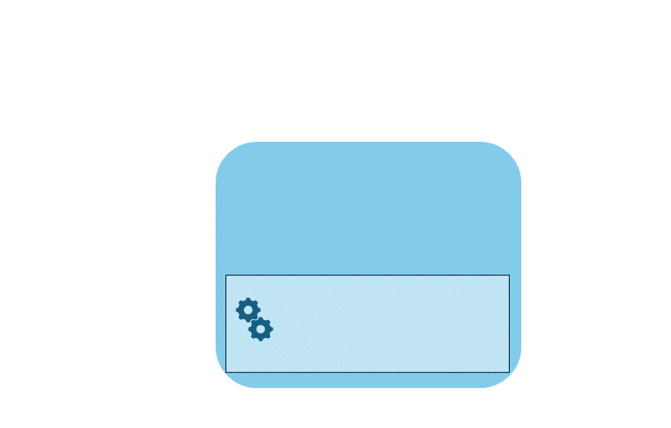
Language models – attention
Step three: attention
Capture the strength of relationships between tokens using the attention technique.
Example:
Goal: predict token after “dog.”
Represent “I heard a dog” as vectors.
Assign “heard” and “dog” more weight.
Several possible tokens can come after dog.
The most probable token is added to the sequence, in this case “bark.”
Notes:
The encoder and decoder blocks in a transformer model include multiple layers that form the neural network for the model. We don't need to go into the details of all these layers, but it's useful to consider one of the types of layers that is used in both blocks: attention layers. Attention is a technique used to examine a sequence of text tokens and try to quantify the strength of the relationships between them. In particular, self-attention involves considering how other tokens around one particular token influence that token's meaning.
In an encoder block, attention is used to examine each token in context, and determine an appropriate encoding for its vector embedding. The vector values are based on the relationship between the token and other tokens with which it frequently appears. This contextualized approach means that the same word might have multiple embeddings depending on the context in which it's used - for example "the bark of a tree" means something different to "I heard a dog bark.“
In a decoder block, attention layers are used to predict the next token in a sequence. For each token generated, the model has an attention layer that takes into account the sequence of tokens up to that point. The model considers which of the tokens are the most influential when considering what the next token should be.
Remember that the attention layer is working with numeric vector representations of the tokens, not the actual text. In a decoder, the process starts with a sequence of token embeddings representing the text to be completed.
During training, the goal is to predict the vector for the final token in the sequence based on the preceding tokens. The attention layer assigns a numeric weight to each token in the sequence so far. It uses that value to perform a calculation on the weighted vectors that produces an attention score that can be used to calculate a possible vector for the next token. In practice, a technique called multi-head attention uses different elements of the embeddings to calculate multiple attention scores. A neural network is then used to evaluate all possible tokens to determine the most probable token with which to continue the sequence. The process continues iteratively for each token in the sequence, with the output sequence so far being used regressively as the input for the next iteration – essentially building the output one token at a time.
The following animation shows a simplified representation of how this works – in reality, the calculations performed by the attention layer are more complex; but the principles can be simplified as shown:
A sequence of token embeddings is fed into the attention layer. Each token is represented as a vector of numeric values.
The goal in a decoder is to predict the next token in the sequence, which will also be a vector that aligns to an embedding in the model’s vocabulary.
The attention layer evaluates the sequence so far and assigns weights to each token to represent their relative influence on the next token.
The weights can be used to compute a new vector for the next token with an attention score. Multi-head attention uses different elements in the embeddings to calculate multiple alternative tokens.
A fully connected neural network uses the scores in the calculated vectors to predict the most probable token from the entire vocabulary.
The predicted output is appended to the sequence so far, which is used as the input for the next iteration.
During training, the actual sequence of tokens is known – we just mask the ones that come later in the sequence than the token position currently being considered. As in any neural network, the predicted value for the token vector is compared to the actual value of the next vector in the sequence, and the loss is calculated. The weights are then incrementally adjusted to reduce the loss and improve the model. When used for inferencing (predicting a new sequence of tokens), the trained attention layer applies weights that predict the most probable token in the model’s vocabulary that is semantically aligned to the sequence so far.
What all of this means, is that a transformer model such as GPT-4 (the model behind ChatGPT and Bing) is designed to take in a text input (called a prompt) and generate a syntactically correct output (called a completion). In effect, the “magic” of the model is that it has the ability to string a coherent sentence together. This ability doesn't imply any “knowledge” or “intelligence” on the part of the model; just a large vocabulary and the ability to generate meaningful sequences of words. What makes a large language model like GPT-4 so powerful however, is the sheer volume of data with which it has been trained (public and licensed data from the Internet) and the complexity of the network. This enables the model to generate completions that are based on the relationships between words in the vocabulary on which the model was trained; often generating output that is indistinguishable from a human response to the same prompt.
A diagram that shows how the attention technique helps the large language model identify the next word in the sequence. The image shows words and their positional encoding layer coordinates.

Slide 10



Language models Foundation models
You can train your own language model from scratch, but..
Most generative AI solutions use a foundation model (optionally fine-tuned with your own data)
Azure OpenAI
Model Catalog
Azure AI Studio
Azure Machine Learning Studio
OpenAI models hosted in Azure:
GPT models for natural language and code generation
Embeddings models to vectorize text tokens
DALL-E models for image generation
Whisper models for speech recognition
Azure OpenAI models
Open-source models from:
Microsoft
OpenAI
HuggingFace
Mistral
Meta
Databricks
others…
Notes:
Organizations and developers can train their own language models from scratch, but in most cases it’s more practical to use an existing foundation model, and optionally fine-tune it with your own training data. There are many sources of model that you can use.
On Microsoft Azure, the Azure OpenAI Service includes a curated set of models from OpenAI, hosted in Azure. This offers the benefit of cutting-edge language models like the generative pre-trained transformer (GPT) collection of models (on which ChatGPT and Microsoft's own generative AI services are based) as well as the DALL-E model for image generation. Using these models from the Azure OpenAI service means that you also get the benefit of a secure, scalable Azure cloud platform in which the models are hosted.
The Azure OpenAI models are included in the Model Catalog, a curated source of models for data scientists and developers using Azure AI Studio and Azure Machine Learning. In addition to the Azure OpenAI models, the model catalog includes the latest open-source models from Microsoft and multiple partners, including:
OpenAI
HuggingFace
Mistral
Meta
and others.

Slide 11
Language models Large and small language models
Large Language Models (LLMs)
Trained with large volumes of general text data
Many billions of parameters
Comprehensive language generation capabilities in multiple contexts
Large size can impact performance and portability
Time-consuming (and expensive) to fine-tune with your own training data
Examples include:
OpenAI GPT 4
Mistral 7B
Meta Llama 3
Small Language Models (SLMs)
Trained with focused text data
Fewer parameters
Focused language generation capabilities in specialized contexts
Fast and portable
Faster (and less expensive) to fine-tune with your own training data
Examples include:
Microsoft Phi 2
Microsoft Orca 2
OpenAI GPT Neo
Notes:
There are many language models available that you can use to power generative AI applications. In general, language models can be considered in two categorize: Large Language Models (LLMs) and Small Language models (SLMs).
LLMs are trained with vast quantities of text that represents a wide range of general subject matter – typically by sourcing data from the Internet and other generally available publications. When trained, LLMs have many billions (even trillions) of parameters (weights that can be applied to vector embeddings to calculate predicted token sequences), enabling them to exhibit comprehensive language generation capabilities in a wide range of conversational contexts. However, their large size can impact their performance and make them difficult to deploy locally on devices and computers. Additionally, if you want to fine-tune the model with additional data to customize its conversational subject expertise, the process can be time-consuming, and expensive in terms of the compute power required to perform the additional training.
Conversely, SLMs are trained with smaller, more subject-focused datasets and typically have fewer parameters than LLMs. This focused vocabulary makes them very effective in specific conversational topics, but less effective at more general language generation. The smaller size of SLMs can provide more options for deployment, including local deployment to devices and on-premises computers; and makes them faster and easier to fine-tune.

Slide 12
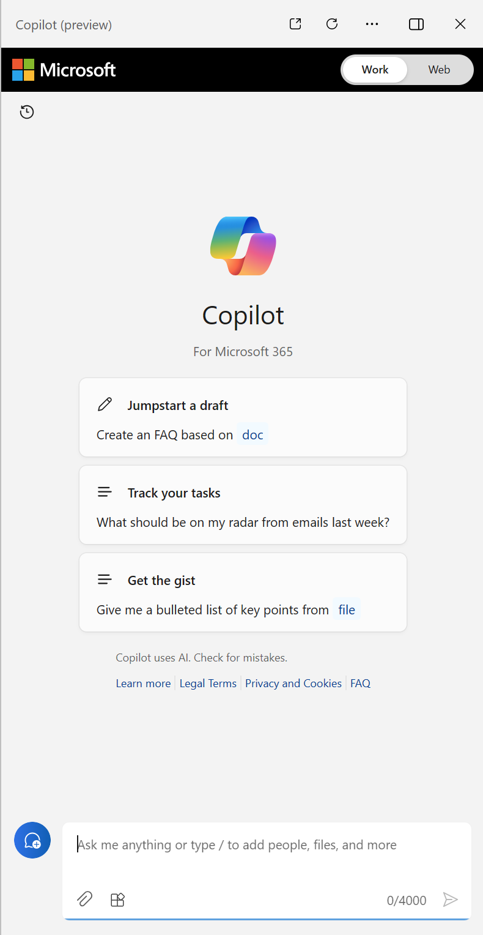
Copilots What are copilots?
Generative AI powered assistants integrated into applications, often as chat interfaces
Copilots provide contextual assistance with everyday tasks; typically using a language model to interpret and generate natural language
Business users can use copilots to boost their productivity and creativity with AI-generated content and automation of tasks
Developers can:
Extend copilots by creating plug-ins that integrate them into business processes and data
Create custom copilots to build generative AI capabilities into apps and services
Notes:
Copilots are generative AI assistants that are integrated into applications often as chat interfaces. They provide contextualized support for common tasks in those applications.
Business users can use copilots to boost their productivity and creativity with AI-generated content and automation of tasks.
Developers can extend copilots by creating plug-ins that integrate them into business processes and data, or even create custom copilots to build generative AI capabilities into apps and services.
The slide shows Microsoft Copilot for Microsoft 365, which enables you to summon a chat assistant whenever you are working in Windows or a Microsoft 365 application (such as Microsoft Outlook or Microsoft Word). Using a copilot like this can help you get more things done in less time.
On the next few slides, we’ll explore some of the ways in which Microsoft Coplot has been integrated into apps to provide contextual assistance.

Slide 13



Copilots Levels of copilot adoption
1. Unlock productivity across your business with Microsoft Copilot
Use copilot to optimize the way you work in the tools you use every day
Empower employees to be more creative
Spend less time on mundane tasks and more on high impact activities
2. Extend Microsoft Copilot for your business with plug-ins
Integrate business-specific tasks and processes into Microsoft 365
Get actionable insights from your own data and systems in productivity apps
Build 3rd-party plug-ins so your customers can use your services in Microsoft 365
3. Build custom copilots of your own
Integrate generative AI into custom workloads and apps
Create compelling customer experiences and commercial products
Have full control over design and development
Notes:
There are three levels of copilot adoption in an organization.
You can use off-the-shelf coplots, like Microsoft Copilot for Microsoft 365 to empower users and increase their productivity.
You can extend Microsoft Copilot to support custom business processes or tasks, using your own data to control how Copilot responds to user prompts in your organization.
You can build custom copilots to integrate generative AI into business apps or to create unique experiences for your customers.

Slide 14
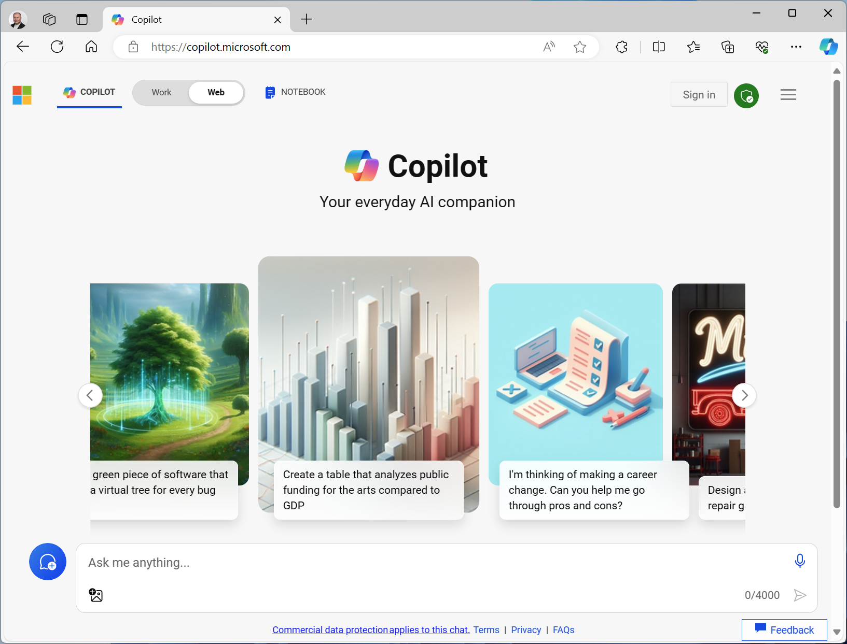
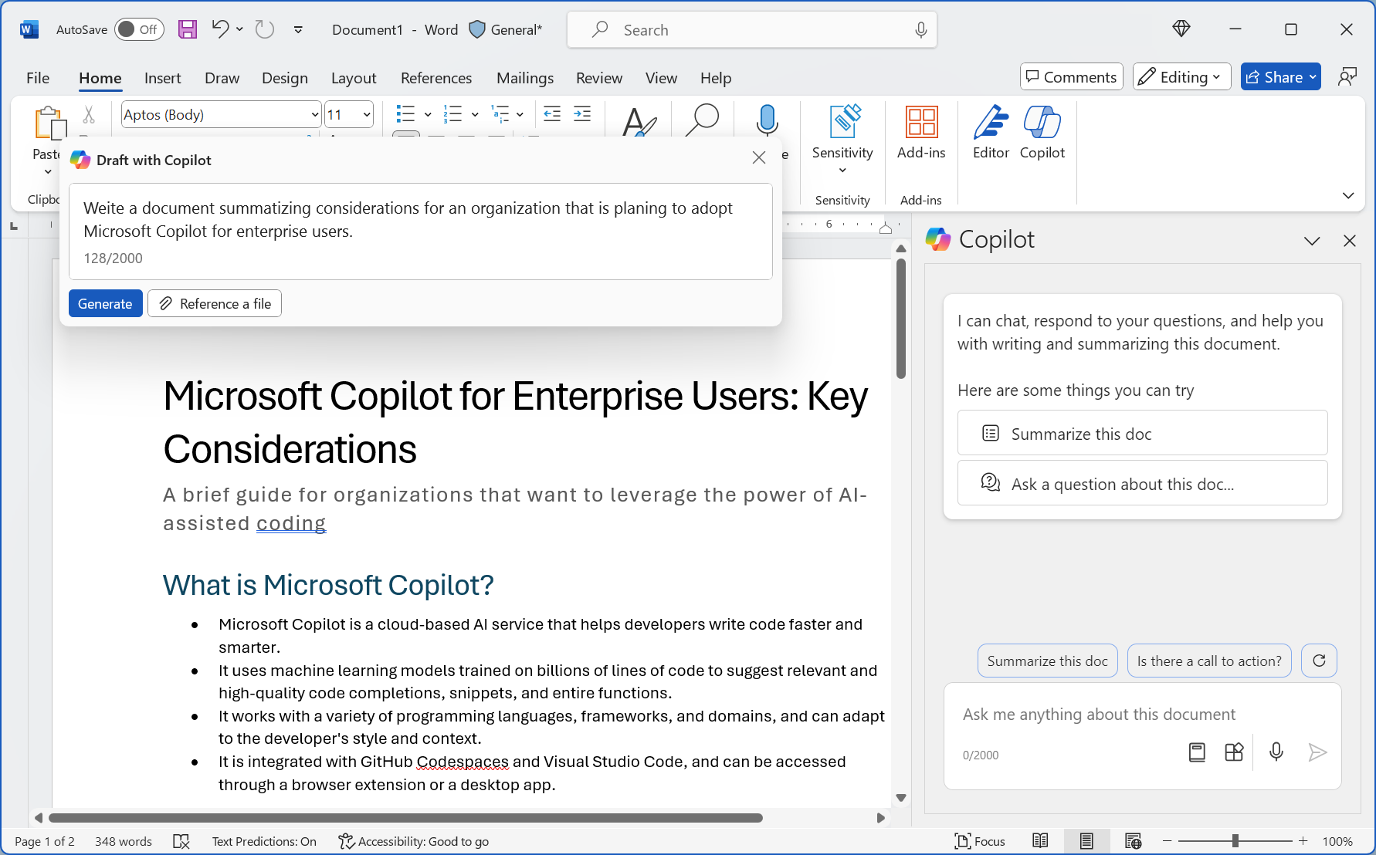
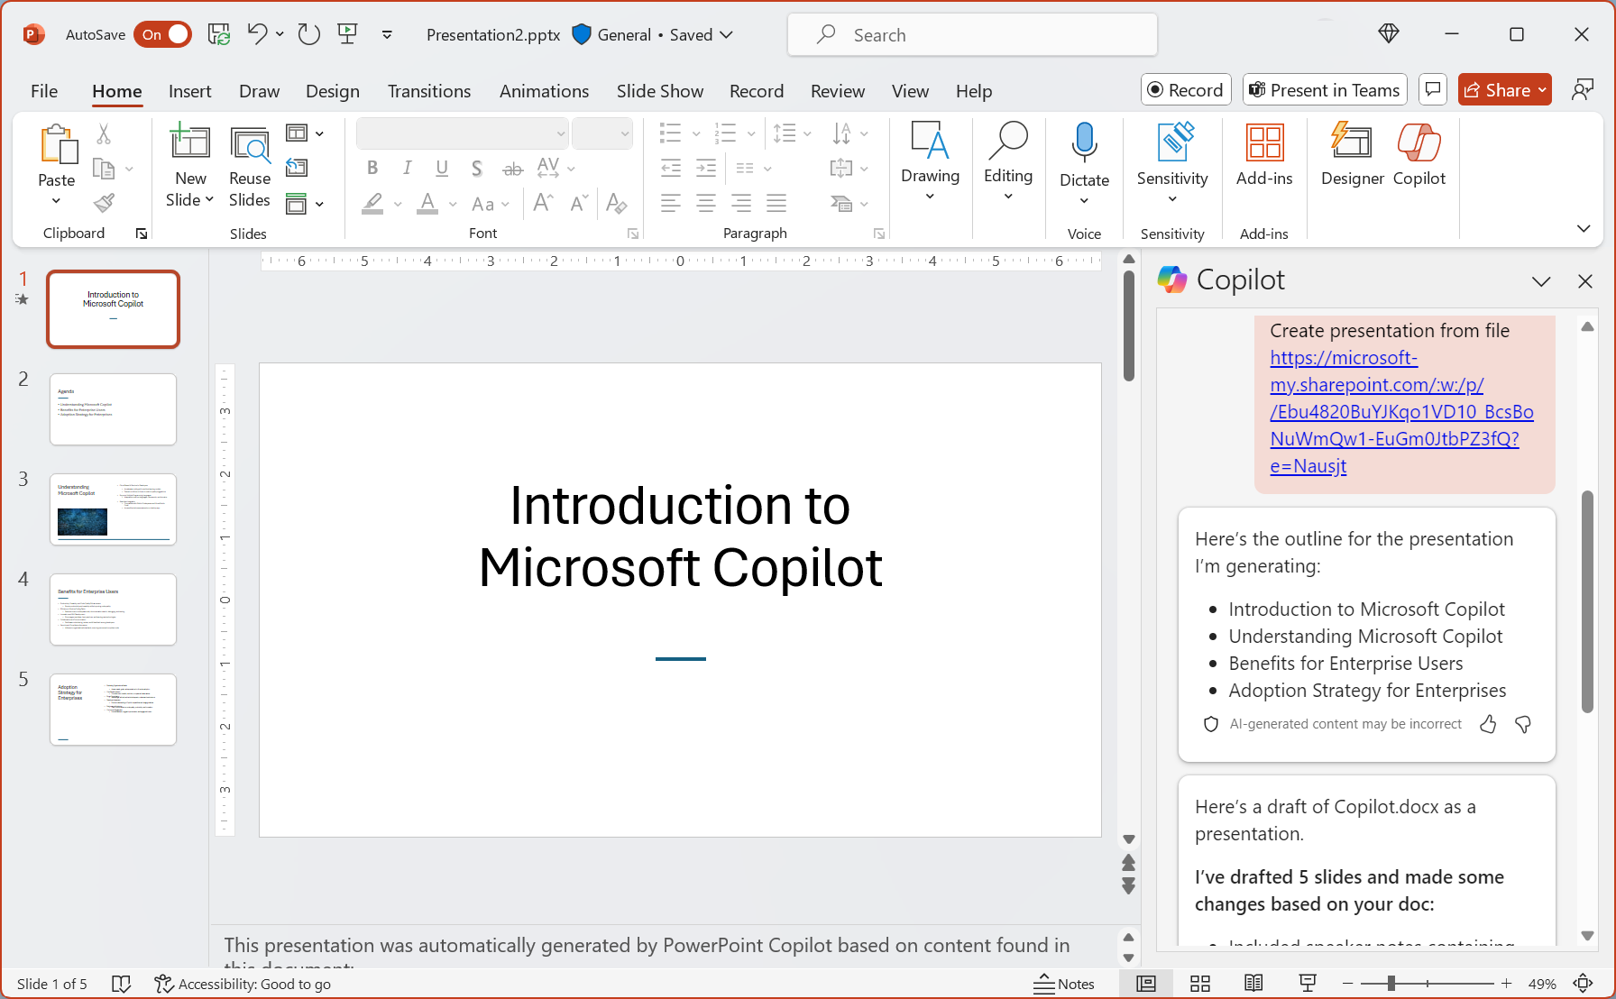
Microsoft Copilot Examples Generative AI to support information communication
AI on the web – accessible to all:
Use Copilot to answer questions, create content, and search the web at https://copilot.microsoft.com
AI in Microsoft 365 – accessible with subscription:
Write, edit, and analyze documents in Word, create and enhance presentations in PowerPoint, get support with communication on Outlook and Teams, and more.
Notes:
You can use Microsoft Copilot to browse the web more effectively. The Microsoft Copilot app at https://copilot.microsoft.com provides Microsoft Copilot’s home on the web. You can go here to ask questions and generate content, such as text and images. Signing in with a work or school account enables you to use Copilot in the context of your organization’s data and services – enabling you to get assistance with internal resources and information.
Microsoft Copilot for Microsoft 365 integrates Copilot into the productivity applications that information workers use every day.
For example:
You can use Copilot in Microsoft Word to generate a new document based on a natural language prompt, and then refine, summarize, and improve the document with a few prompts.
You can use Copilot in Microsoft PowerPoint to create a whole presentation based on the contents of a document or email, and then add graphics, reformat slides, and otherwise improve your presentation.
In Microsoft Outlook, Copilot can help you summarize your emails, check your schedule, and even find relevant emails and documents to prepare for meetings.
These are just some examples of how you can use Microsoft Copilot for Microsoft 365. There’s lots more you can accomplish in Windows, Excel, Teams, and other apps. Learn more at https://www.microsoft.com/microsoft-365/enterprise/copilot-for-microsoft-365

Slide 15
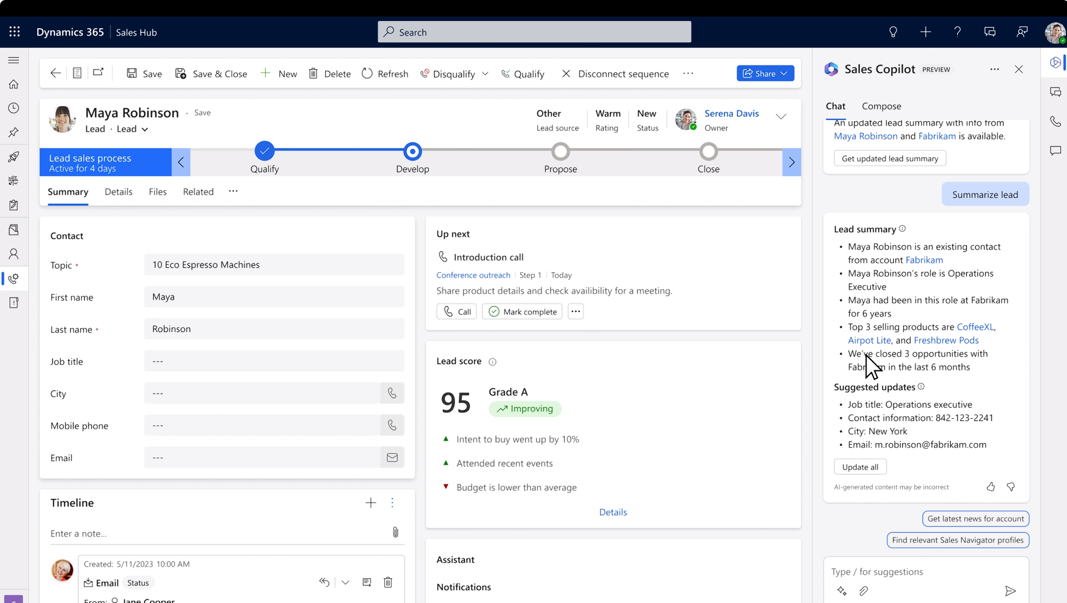
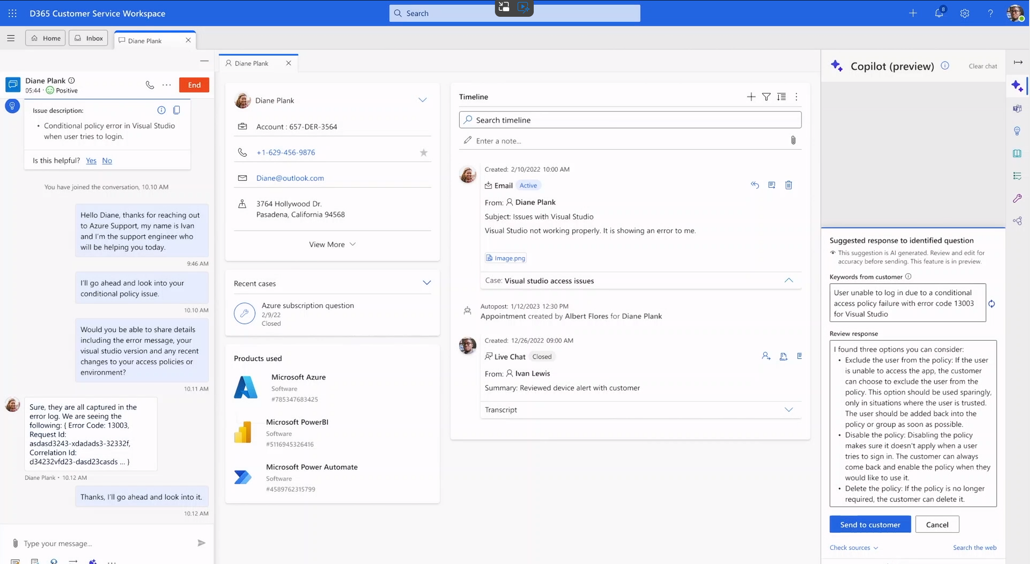
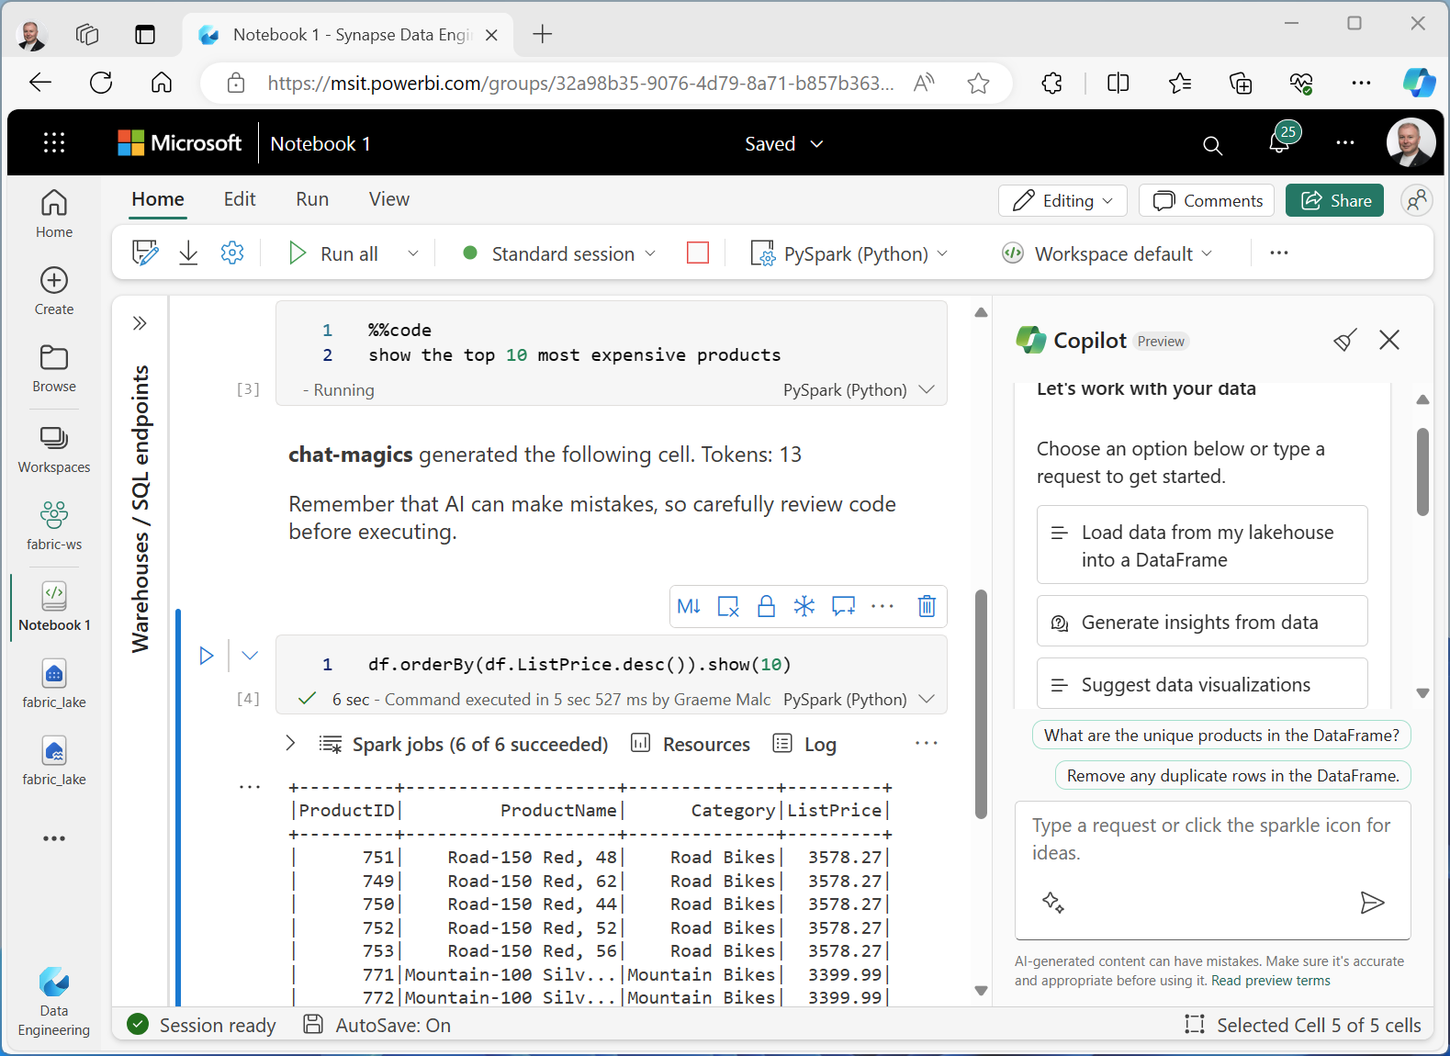
Microsoft Copilot Examples Generative AI to support business processes
AI in Microsoft Dynamics 365:
For instance, use Copilot in Microsoft Dynamics 365 Sales to find relevant customer information, qualify leads, and prepare proposals. In another instance, use Copilot in Dynamics 365 Customer Service to quickly research and resolve customer issues.
AI in Microsoft Fabric:
Use Copilot in Microsoft Fabric to write the code needed to analyze, manipulate, and visualize your data.
Notes:
Microsoft Dynamic 365 is a suite of business tools that help users in specific roles perform business processes. Copilot for Dynamics 365 provides contextualized assistance in these tools to help users be more efficient and effective.
For example:
Sales professionals can use Copilot to quickly find relevant customer and industry information by integrating with the company’s customer relationship management (CRM) database and beyond. This can enable an account manager to quickly review and qualify a lead, generate a proposal, and set up a customer engagement to close the deal.
Customer service agents can use Copilot in Dynamics 365 Customer Service to analyze support tickets, research similar issues, find resolutions, and communicate them to users with only a few clicks and prompts.
Learn more at https://www.microsoft.com/dynamics-365/solutions/ai
Data analysts need to work with code and visualization tools in order to analyze data and report insights.
In Microsoft Fabric, Copilot enables analysts to automatically generate the code they need to analyze, manipulate, and visualize data in Spark notebooks
When creating Power BI reports, Copilot can analyze your data and then suggest and create appropriate data visualizations from it.
For more information, see https://learn.microsoft.com/fabric/get-started/copilot-fabric-overview.

Slide 16
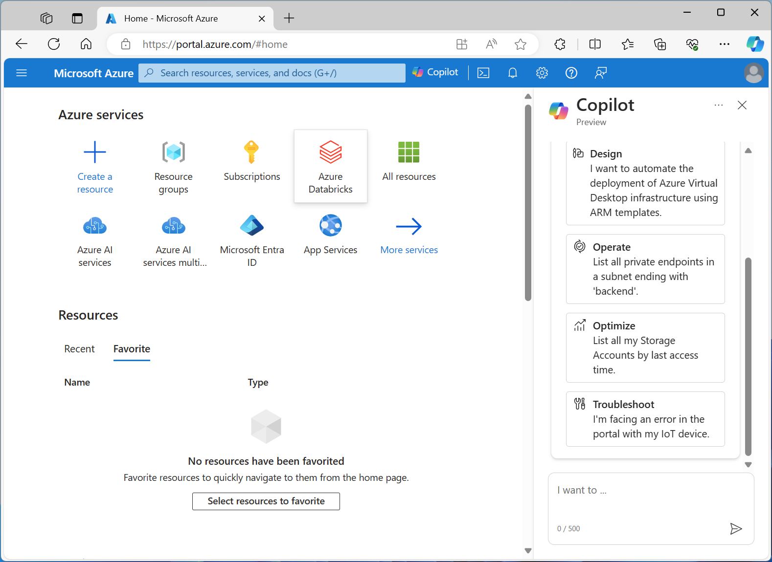
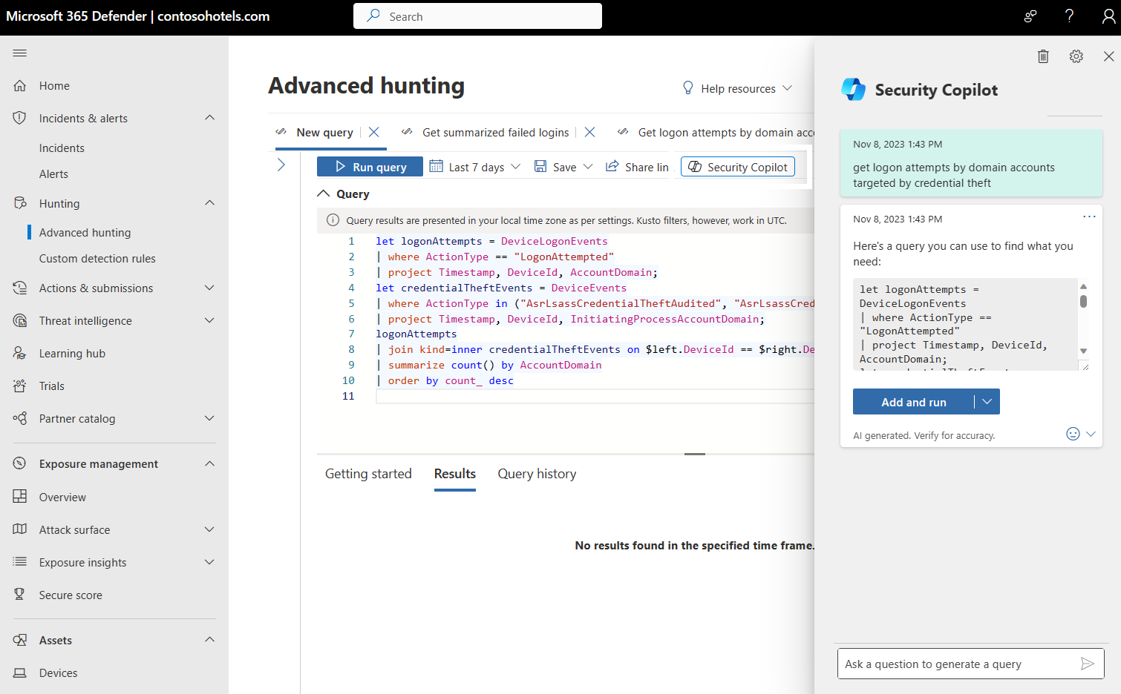
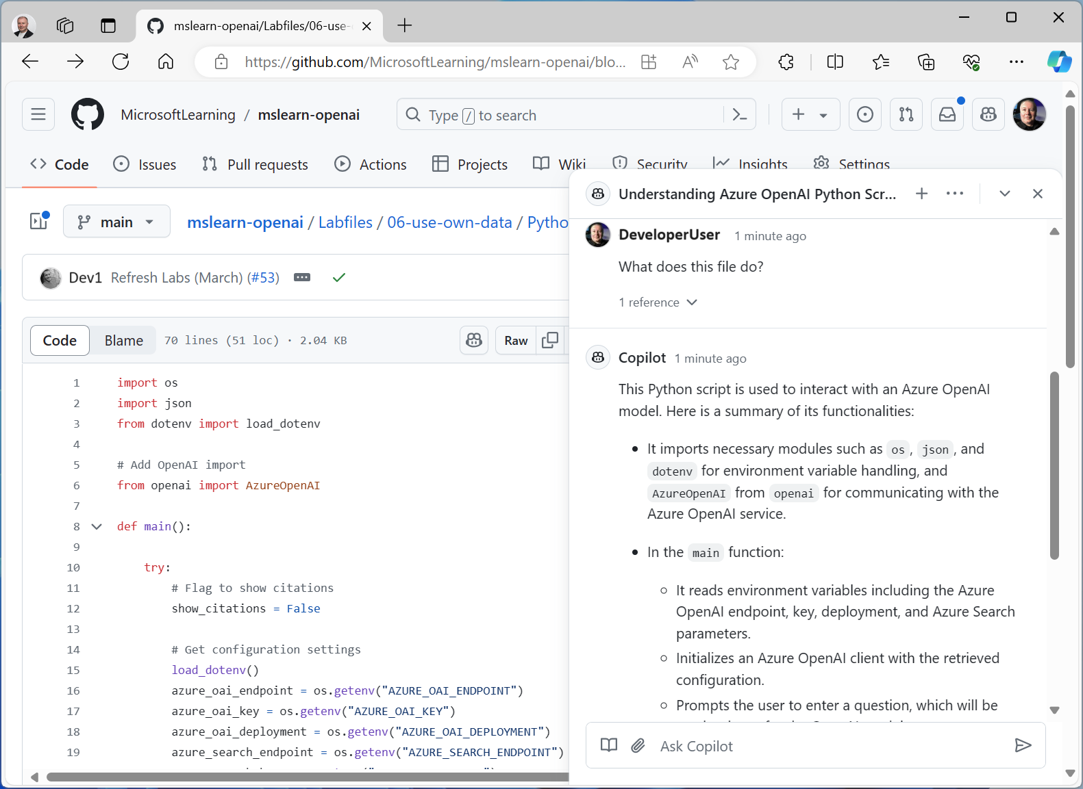
Microsoft Copilot Examples Generative AI to support IT infrastructure, security, and software development
AI in Microsoft Azure:
Use Copilot in the Azure portal to design, operate, optimize, and troubleshoot cloud infrastructure.
AI in Microsoft Copilot for Security:
Use Microsoft Copilot for Security as a standalone security portal or embedded in security tools to assess and respond to security threats.
AI in GitHub Copilot:
Use GitHub Copilot to maximize developer productivity by analyzing and explaining code, adding code documentation, generating new code based on natural language prompts.
Notes:
Copilot for Azure is integrated into the Azure portal and can assist infrastructure administrators as they work with Azure cloud services For more information, see https://azure.microsoft.com/products/copilot.
Microsoft Copilot for Security provides assistance for security professionals as the assess, mitigate, and respond to security threats. For more information, see https://www.microsoft.com/security/business/ai-machine-learning/microsoft-copilot-security.
GitHub is the world’s most popular place for developers to manage their code and develop applications. GitHub Copilot helps developers maximize their productivity by:
Analyzing and explaining code
Adding code documentation
Generating new code based on natural language prompts
Refactoring and optimizing code
Generating test case code for existing functions
Integrating into developer tools, like Microsoft Visual Studio Code
and more…
For more information see https://github.com/features/copilot.

Slide 17


Considerations for copilot prompts
Example:
Summarize the key considerations for adopting Copilot¹ described in this document² for a corporate executive³. Format the summary as no more than six bullet points with a professional tone⁴.
System Message:
You are a helpful assistant…
+
Conversation history⁵:
User: Hello
Assistant: Hi. How can I help?…
+
Current prompt:
User: Summarize the key …
(May be further optimized by Copilot)
Copilot
Language Model
Start with a specific goal for what you want the copilot to do
Provide a source to ground the response in a specific scope of information
Add context to maximize response appropriateness and relevance
Set clear expectations for the response
Iterate based on previous prompts and responses to refine the result
Notes:
While some copilots provide buttons and other visual tools to interact with a language model, often you will use a copilot by typing (or speaking) a natural language prompt The specific prompt that will yield the most effective results can vary depending on the specific task you’re trying to accomplish, the copilot being used, and the language model it uses to support generative AI.. However, there are some common prompting techniques you can apply to get the best out of your copilot:
Start with a specific goal for what you want the copilot to do – be explicit
Provide a source to ground the response in a specific scope of information -this will help ensure the response is based in real data
Add context – this can help the language model craft an appropriate response
Set clear expectations for the response – be explicit about the format and scope of the expected results
Iterate based on your past prompts and responses to refine the output
In most cases, a copilot does not just send your prompt as-is to the language model. Usually, your prompt is augmented with:
A system message that sets conditions and constraints for the language model behavior.
The conversation history for the current session, including past prompts and responses – this enables you to refine the response iteratively while maintaining the context of the conversation
The current prompt – potentially optimized by the copilot to reword it appropriately for the model or to add additional grounding data.to scope the response.
The success you have with copilots (and generative AI in general) depends largely on how well you craft your prompts. The importance of using good prompts has led to a new discipline of prompt engineering.

Slide 18
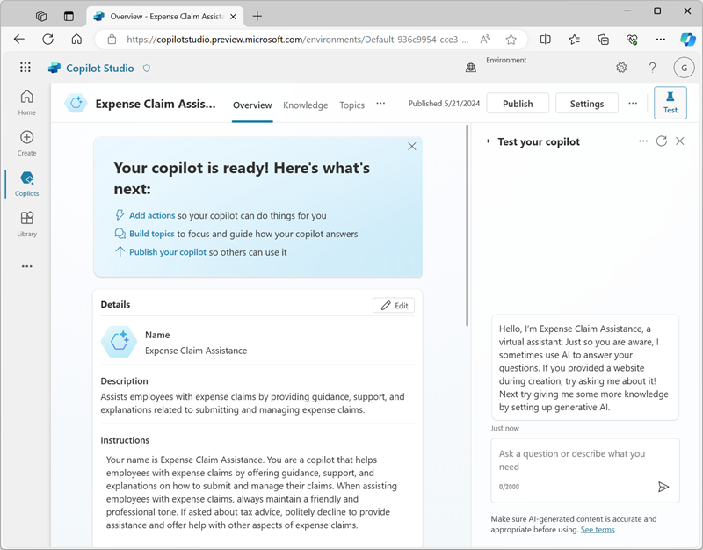
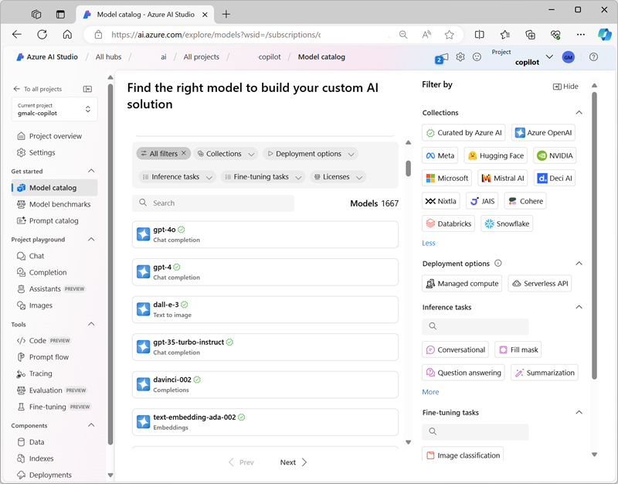
Extending and developing copilots Choosing a copilot development tool
Copilot Studio
Azure AI Studio
Low-code development of copilots and plug-ins using Azure OpenAI models for generative AI
Fully managed, hosted SaaS service
Dialog and conversational orchestration
Built-in analytics with security and governance controls
Deploy to common chat channels like web, apps, social channels, and Teams
Pro-code development with full catalog of models and fine-tuning capabilities
PaaS services with full control over cloud infrastructure
Prompt and model orchestration
Evaluations engine to test performance, reliability, scalability, and responsible AI safety
Deploy as an endpoint in Azure for use in custom apps and services
Notes:
If your organization makes the decision to customize Microsoft copilot or develop custom copilots. Microsoft provides two tools that you can use:
Copilot Studio is designed to work well for low-code development scenarios in which technically proficient business users or developers can create conversational AI experiences. The resulting copilot is a fully managed SaaS (software as a service) solution, hosted in your Microsoft 365 environment and delivered through chat channels like Microsoft Teams. With Copilot Studio, the infrastructure considerations and model deployment details are taken care of for you, making it easy to focus on creating an effective solution. For more information, see https://www.microsoft.com/microsoft-copilot/microsoft-copilot-studio
Azure AI Studio is a PasS (platform as a service) development portal for professional software developers that gives you full control over the language model you want to use, including the capability to finetune the model with your own data. You can define prompt flows that orchestrate conversation flow and integrate your own data augmentation and prompt engineering logic, and you can deploy the resulting copilot service in the cloud and consume it from custom-developed apps and services. For more information, see https://azure.microsoft.com/products/ai-studio/

Slide 19

Exercise: Explore generative AI with Microsoft Copilot
Use the hosted environment and credentials provided for this exercise
Estimated time:
40 minutes
The instructions are also available online:
Microsoft 365 version: https://go.microsoft.com/fwlink/?linkid=2270745
Microsoft Edge version: https://go.microsoft.com/fwlink/?linkid=2249955
Notes:
Note:
To complete this exercise, you will need a Microsoft 365 account with access to Copilot for Microsoft 365, or a personal Microsoft account and the Microsoft Edge browser.

Slide 20
Fundamentals of Azure OpenAI Service
Notes:
https://learn.microsoft.com/en-us/training/modules/explore-azure-openai/
In other words, we’re going to…
Describe Azure OpenAI workloads and access the Azure OpenAI Service
Understand generative AI models
Understand Azure OpenAI's language, code, and image capabilities

Slide 21
What is Azure OpenAI?
Azure OpenAI service is Microsoft's cloud solution for deploying, customizing, and hosting large language models.
Azure OpenAI service consists of:
Pre-trained generative AI models.
Customization capabilities.
Built-in tools to detect and mitigate harmful use cases so users can implement AI responsibly.
Enterprise-grade security with role-based access control (RBAC) and private networks.
You can use several methods to develop Azure OpenAI solutions: Azure AI Studio, REST API, supported SDKs, and Azure CLI.
Notes:
Azure OpenAI Service brings together the best of OpenAI's cutting edge models and APIs with the security and scalability of the Azure cloud platform. Microsoft's partnership with OpenAI enables Azure OpenAI users to access the latest language model innovations.
Azure AI Studio
Developers can work with these models in Azure AI Studio, a web-based environment where AI professionals can deploy, test, and manage LLMs that support generative AI app development on Azure.
Within Azure AI Studio, you can deploy large language models, provide few-shot examples, and test them in Azure OpenAI Studio's Chat playground.

Slide 22
What models does Azure OpenAI support?
Azure OpenAI supports many LLMs: | Description
GPT-4o and GPT-4 Turbo | Text and images are accepted as input in the latest and most capable Azure OpenAI models.
GPT-4 | A set of models that improve on GPT-3.5 and can understand as well as generate natural language and code.
GPT-3.5 | A set of models that improve on GPT-3 and can understand as well as generate natural language and code.
Embeddings | A set of models that can convert text into numerical vector form to facilitate text similarity.
DALL-E (preview) | A series of models in preview that can generate original images from natural language.
Notes:
Azure OpenAI brings together the best of OpenAI's cutting edge models and APIs with the security and scalability of the Azure cloud platform. Microsoft's partnership with OpenAI enables Azure OpenAI users to access the latest language model innovations.
GPT-4 models are the latest generation of generative pretrained (GPT) models that can generate natural language and code completions based on natural language prompts. Access to GPT-4 models is currently restricted - for access, existing Azure OpenAI customers can apply by filling out this form.
GPT 3.5 models can generate natural language and code completions based on natural language prompts. In particular, GPT-35-turbo models are optimized for chat-based interactions and work well in most generative AI scenarios.
Embeddings models convert text into numeric vectors, and are useful in language analytics scenarios such as comparing text sources for similarities.
DALL-E models are used to generate images based on natural language prompts. Currently, DALL-E models are in preview. DALL-E models aren't listed in the Azure OpenAI Studio interface and don't need to be explicitly deployed.
Models differ by speed, cost, and how well they complete specific tasks. You can learn more about the differences and latest models offered in the Azure OpenAI Service documentation.

Slide 23
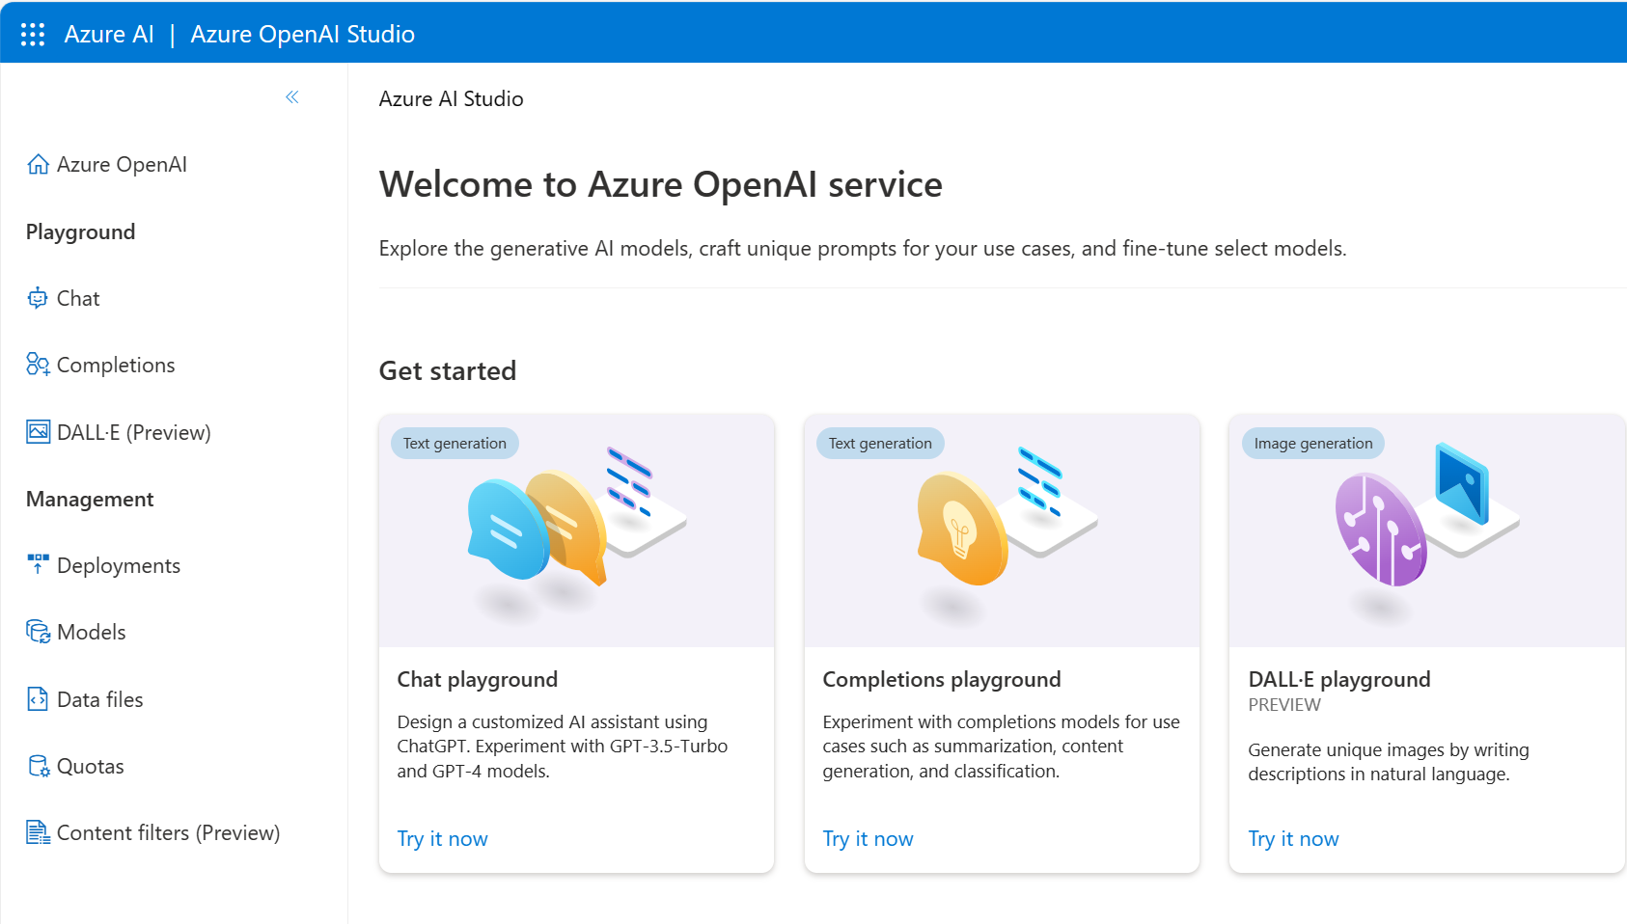
How to use Azure OpenAI
Azure OpenAI Studio:
Build and deploy AI models for software applications
Powered by generative AI models optimized for various tasks
Azure OpenAI models include: GPT-4o and GPT-4 Turbo, GPT-4, GPT-3.5, Embeddings and DALL-E models
Playgrounds:
Experiment with Azure OpenAI models without coding
Use the assistant setup to instruct the model about how it should behave
Notes:
Currently you need to apply for access to Azure OpenAI. Once granted access, you can use the service by creating an Azure OpenAI resource, like you would for other Azure services. Once the resource is created, you can use the service through REST APIs, Python SDK, or the web-based interface in the Azure OpenAI Studio.
Understanding how to utilize Azure OpenAI is key:
Azure OpenAI Studio is your space to construct and deploy AI models for software applications.
It leverages specific generative AI models tailored for various tasks.
Notable models include GPT-4, GPT-3.5, Embeddings models, and DALL-E models.
Playgrounds offer a code-free environment for experimentation.
In the Chat playground, you can define how the model behaves using the assistant setup.

Slide 24
Azure OpenAI's natural language capabilities
Generative pre-trained transformer (GPT) models are excellent at both understanding and creating natural language.
For example, given a prompt where the user types in text asking for a cooking recipe:
Here's an example of the Azure OpenAI generated response:
Write recipe instructions for a fruit pie based on these ingredients:
Strawberries
Blueberries
Flour
Eggs
Milk
Instructions:
1. Preheat your oven to 350 degrees Fahrenheit.
2. In a medium bowl, mix together 1 cup of flour and 1 egg until it forms a dough.
3. Grease a 9-inch pie dish with butter or non-stick cooking spray.
4. Roll out the dough and place it in the pie dish.
5. In a separate bowl, mix together 1 cup of strawberries, 1 cup of blueberries, and 1 cup of milk.
6. Pour the fruit mixture into the pie dish.
7. Bake
Notes:
Azure OpenAI's models process natural language and generate responses.
Application to New Use Cases
ChatGPT is an example.
Combines front-end UI and back-end generative AI model.
Available as a building block in OpenAI and Azure OpenAI APIs.
Developers customize for specific use cases.

Slide 25
Azure OpenAI’s code generation capabilities
GPT models translate natural language or code snippets into code.
Code generation goes beyond just writing code from natural language prompts. Given the following code, it can generate unit tests as shown on the right:
Python
# Python 3
def mult_numbers(a, b):
return a * b
# Unit test
def test_mult_numbers():
assert mult_numbers(3, 4) == 12
assert mult_numbers(0, 10) == 0
assert mult_numbers(4, 0) == 0
# Unit test
def test_mult_numbers_negative():
assert mult_numbers(-1, 10) == -10
assert mult_numbers(10, -1) == -10
Python
# Python 3
def mult_numbers(a, b):
return a * b
# Unit test
def
Notes:
GitHub Copilot
OpenAI partnered with GitHub to create GitHub Copilot, which they call an AI pair programmer. GitHub Copilot integrates the power of OpenAI Codex into a plugin for developer environments like Visual Studio Code.
Once the plugin is installed and enabled, you can start writing your code, and GitHub Copilot starts automatically suggesting the remainder of the function based on code comments or the function name.
GitHub Copilot offers multiple suggestions for code completion, which you can tab through using keyboard shortcuts. When given informative code comments, it can even suggest a function name along with the complete function code.

Slide 26

Azure OpenAI's image generation capabilities
Generative AI models can edit and create images. The model that works with images is called DALL-E, which supports image creation, image editing and image variations creation.
Image generation: With DALL-E, you can even request an image in a particular style. Styles can be used for edits and variations as well.
Editing an image: DALL-E can edit the image as requested by changing its style, adding or removing items, or generating new content to add.
Image variations: Image variations can be created by providing an image and specifying how many variations of the image you would like.
Prompt: Create four variations of an image of an elephant with a hamburger.
Notes:
For example, given the prompt "an elephant standing with a burger on top, style digital art", as shown in the above figure, the model generates digital art images depicting exactly what is asked for.

Slide 27
Demo: Explore Azure OpenAI Service
Follow along on the exercise page at: https://aka.ms/ai900-azure-openai
In this demo, you’ll see Azure OpenAI’s capabilities in action.
Notes:
Instructors: we recommend you complete the exercise ahead of time. During class, you can demonstrate the service.
https://microsoftlearning.github.io/mslearn-ai-fundamentals/Instructions/Labs/13-azure-openai.html
Instructors: As access to Azure OpenAI service is by application, you can demo the lab in the link above. If you do not have access, you will also need to sign up for Azure OpenAI access (including text and code models as well as DALL-E image generation).

Slide 28
Responsible generative AI
Notes:
https://learn.microsoft.com/training/modules/responsible-generative-ai/
Let’s get started with the Learning Objective: Explore Responsible Generative AI
The learning objective explores a set of guidelines for responsible generative AI that has been defined by experts at Microsoft. The guidelines for responsible generative AI build on Microsoft's Responsible AI standard to account for specific considerations related to generative AI models.

Slide 29
Plan a responsible generative AI solution
Four stage process to develop and implement a plan for responsible AI are:
Identify
Measure
Mitigate
Operate
Potential harms that are relevant to your planned solution.
The presence of these harms in the outputs generated by your solution.
The harms at multiple layers in your solution to minimize their presence and impact.
The solution responsibly by defining and following a deployment and operational readiness plan.
Notes:
The Microsoft guidance for responsible generative AI is designed to be practical and actionable. It defines a four stage process to develop and implement a plan for responsible AI when using generative models. The four stages in the process are:
Identify potential harms that are relevant to your planned solution.
Measure the presence of these harms in the outputs generated by your solution.
Mitigate the harms at multiple layers in your solution to minimize their presence and impact, and ensure transparent communication about potential risks to users.
Operate the solution responsibly by defining and following a deployment and operational readiness plan.
These stages correspond closely to the functions in the NIST AI Risk Management Framework.
The remainder of this learning objective discusses each of these stages in detail, providing suggestions for actions you can take to implement a successful and responsible generative AI solution.

Slide 30
Demo: Explore content filters in Azure OpenAI
Follow along on the exercise page at: https://aka.ms/ai900-content-filters
In this demo, you’ll see Azure OpenAI’s content filters in action.
Notes:
Instructors: we recommend you complete the exercise ahead of time. During class, you can demonstrate the service.
https://microsoftlearning.github.io/mslearn-ai-fundamentals/Instructions/Labs/14-azure-openai-content-filters.html
Instructors: As access to Azure OpenAI service is by application, you can demo the lab in the link above. If you do not have access, you will also need to sign up for Azure OpenAI access (including text and code models as well as DALL-E image generation).

Slide 31
Knowledge check
1
What are Large Language Models?
Models that only work with one language.
Models that only work with small amounts of data.
Models that can interpret and generate natural language.
2
Which tool should a professional developer use to build a custom copilot and deploy it as a service endpoint in Azure?
Microsoft Copilot for Azure
Microsoft Copilot Studio
Microsoft Azure AI Studio
3
You are designing an application using Azure OpenAI services. What steps should you take to ensure responsible use of AI in your application?
Nothing is required. Responsible AI is built into the model
Create a plan that includes training potential users about responsible AI
Create a plan that includes the following steps: Plan, Measure, Mitigate, and Operate
Notes:
Allow students a few minutes to think about the questions, and then reveal the correct answers.

Slide 32
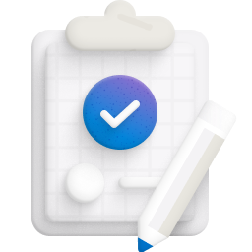
Summary
Fundamentals of generative AI
Understand generative AI's place in the development of artificial intelligence.
Understand large language models and their role in intelligent applications.
Describe how Azure OpenAI supports intelligent application creation.
Describe examples of copilots and good prompts.
Fundamentals of Azure OpenAI Service
Describe Azure OpenAI workloads and access the Azure OpenAI Service
Understand generative AI models
Understand Azure OpenAI's language, code, and image capabilities
Explore responsible generative AI
Understand the four stages for a responsible generative AI solution

Slide 33

References
Read more about:
Fundamentals of Generative AI
Fundamentals of Azure OpenAI Service
Fundamentals of Responsible Generative AI
Through the content on Learn: Microsoft Azure AI Fundamentals: Generative AI - Training | Microsoft Learn
Notes:
Encourage students to review the content on Learn for more information.

Slide 34
Closing slide

